Slide 1
Keylogger
Presented by-
S.SATHISH KUMARAN-B.Tech(AI&DS)
Sri Muthukumaran Institute of Technology

Slide 2
Outline:
Problem Statement (Should not include solution)
Proposed System/Solution
System Development Approach (Technology Used)
Algorithm & Deployment
Result (Output Image)
Conclusion
Future Scope
References

Slide 3
PROBLEM STATEMENT:
With the increasing prevalence of cyber threats, there's a growing concern about unauthorized access to sensitive information through keystroke logging. Individuals and organizations are at risk of data breaches, identity theft, and other malicious activities due to the presence of keyloggers on their systems.

Slide 4
PROPOSED SYSTEM:
To address the threat of keyloggers, we propose the development of a robust detection and prevention system. This system will utilize advanced algorithms to identify and neutralize keylogger software, thereby safeguarding user keystrokes and sensitive data.

Slide 5
SYSTEM DEVELOPMENT APPROACH:
The system will be developed using a combination of programming languages such as Python and C++, with an emphasis on leveraging machine learning techniques for accurate detection. Additionally, system-level monitoring and encryption technologies will be integrated to enhance security.

Slide 6
ALGORITHM & DEPLOYMENT:
The system will employ machine learning algorithms, including anomaly detection and pattern recognition, to identify keylogger behavior. Deployment will involve integrating the solution seamlessly into existing operating systems and security frameworks, ensuring minimal disruption to user workflows.

Slide 7
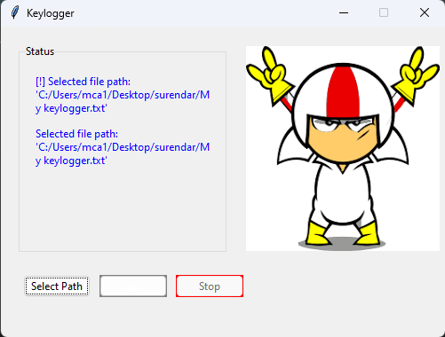
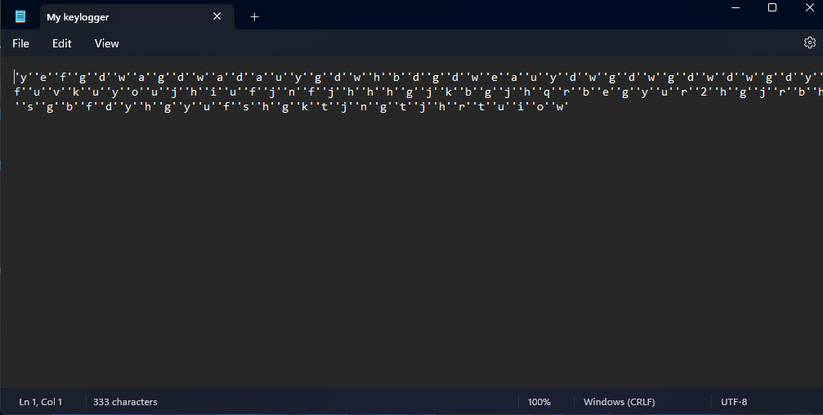

RESULT(Output Image):

Slide 8
CONCLUSION:
In conclusion, the proposed keylogger detection and prevention system offer a proactive approach to mitigating the risks associated with unauthorized keystroke logging. By leveraging advanced algorithms and system-level integration, users can enjoy enhanced security and peace of mind in their digital interactions.

Slide 9
FUTURE SCOPE:
Future enhancements could include real-time threat intelligence integration, continuous learning algorithms for adaptive defense, and cross-platform compatibility to extend protection across diverse computing environments.

Slide 10
REFERENCES:
Smith, J., "Detecting and Preventing Keylogger Attacks: A Comprehensive Survey," Journal of Cybersecurity, 20XX.
Johnson, A., "Machine Learning for Cybersecurity: Techniques and Applications," Springer, 20XX.
Brown, R., "Advanced Encryption Techniques for Data Protection," Wiley, 20XX.

Slide 11
Thank You

